Slide 1
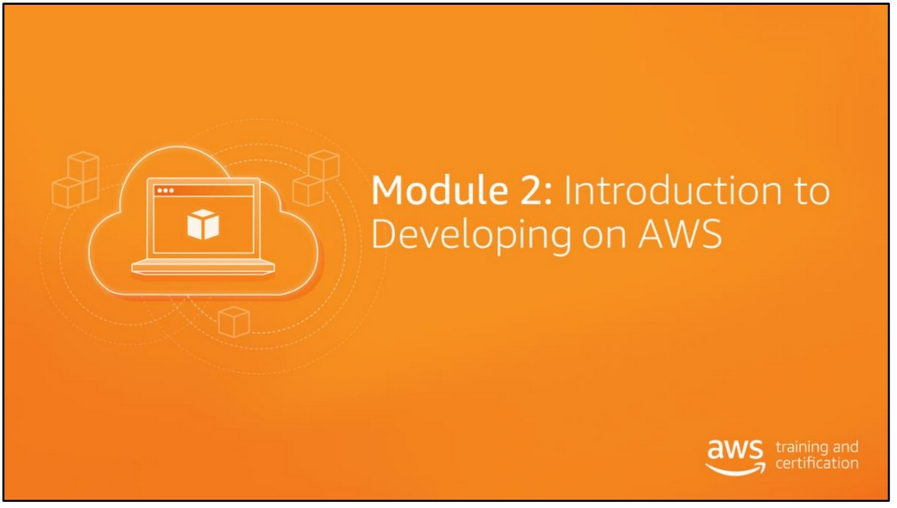

Slide 2
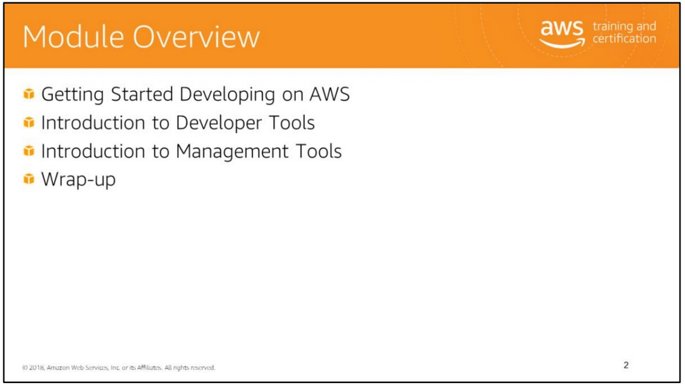

Slide 3
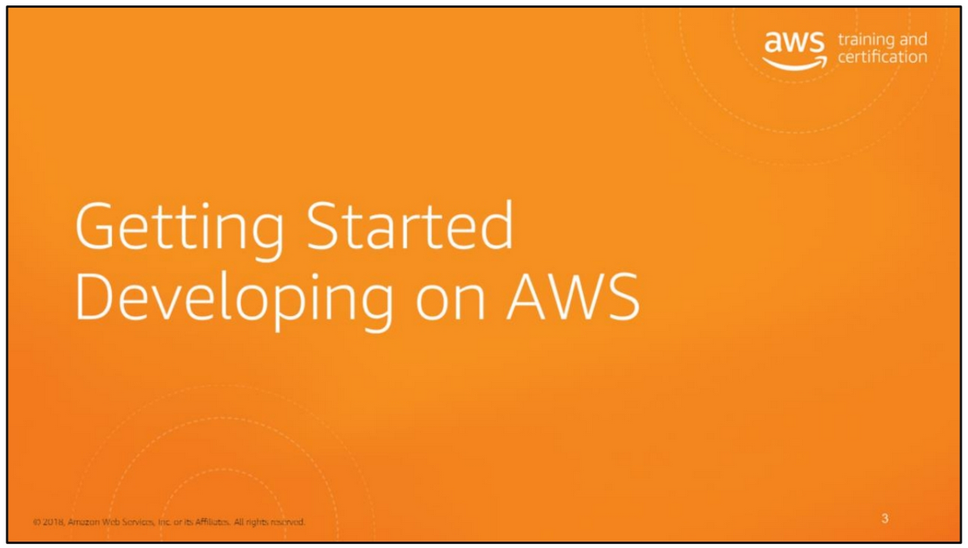

Slide 4
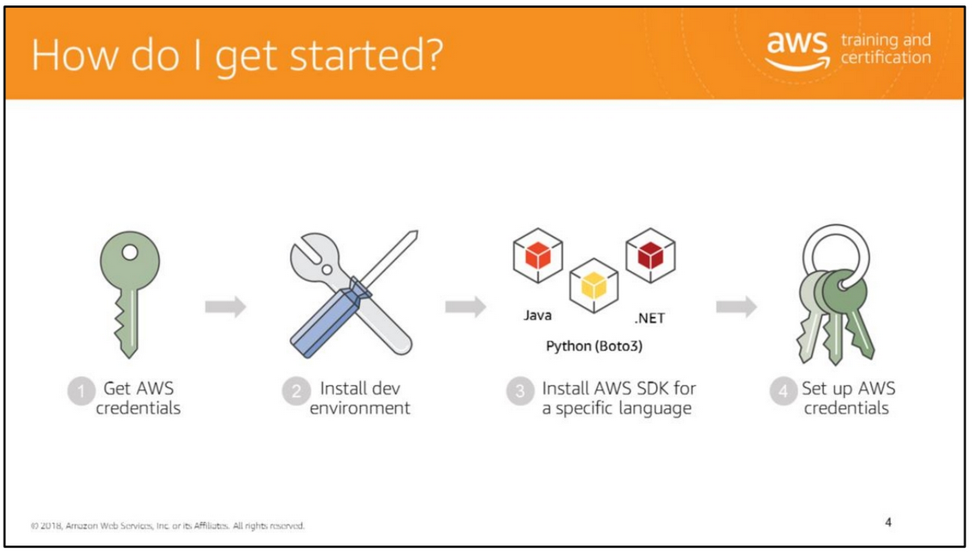
This slide presents an overview of steps that are required to set up your development environment to work with the AWS SDK.
To use the AWS SDK for Java to access Amazon Web Services (AWS), you need an AWS account and AWS credentials. To increase the security of your AWS account, we recommend that you use an IAM user to provide access credentials instead of using your root account credentials.

Slide 5
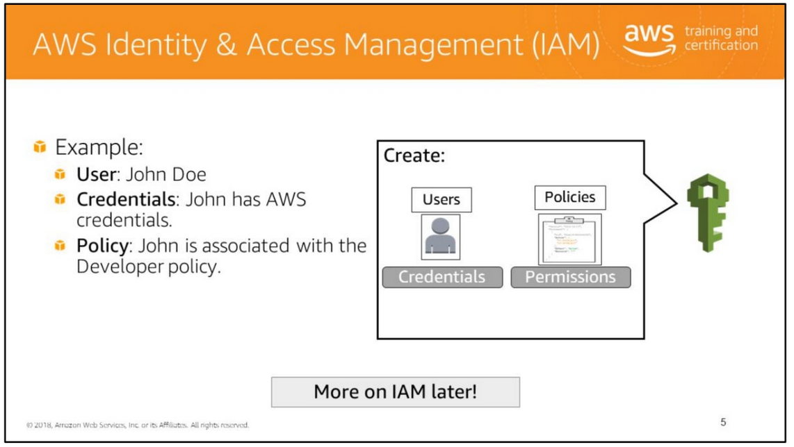
To use the AWS SDK for Java to access Amazon Web Services (AWS), you will need an AWS account and AWS credentials. To increase the security of your AWS account, we recommend that you use an IAM user to provide access credentials instead of using your root account credentials.
IAM enables you to create and manage AWS users and groups. With IAM, you can set up roles and policies to control access to AWS services. IAM also enables identity federation between your corporate directory and AWS services.
For example, you can set up a user account for every developer in your organization. Each user has credentials that they must use to access AWS services. You can create an IAM role for developers and associate the developer role with each developer user account. The developer role can be configured with policies that control which services and operations the role has access to.
When you create IAM policies, follow the standard security advice of granting least privilege—that is, granting only the permissions required to perform a task. Determine what users need to do and then craft policies for them that let the users perform only those tasks.
A role has policies granting access to specific services and operations.

Slide 6
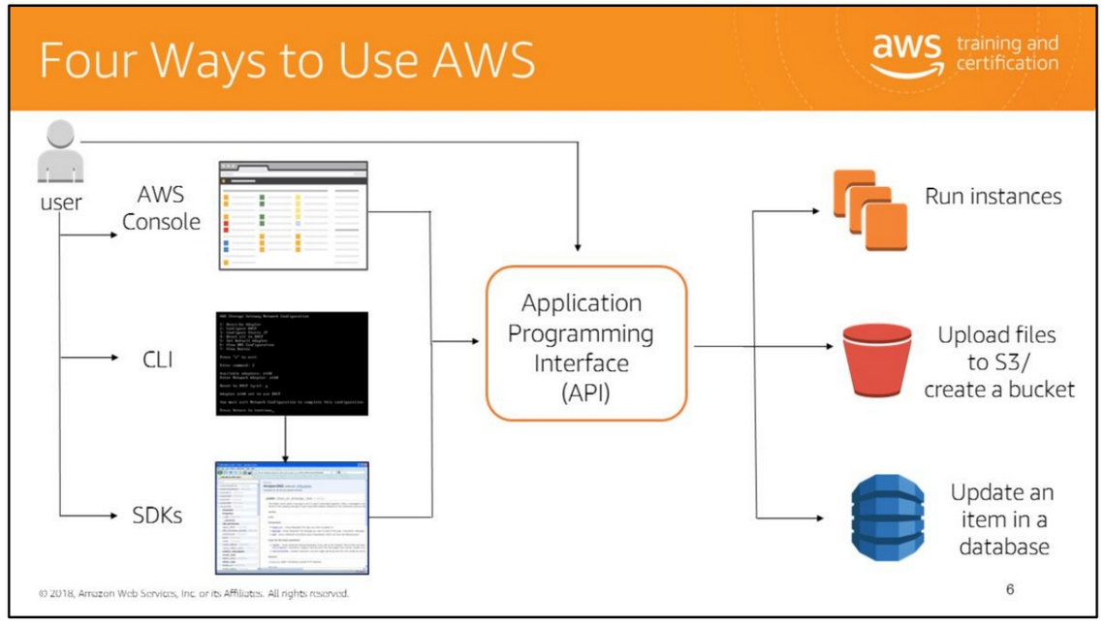
In AWS, all the services are managed through an API and AWS provides an API for each of it’s services. To simplify the process of managing API calls, AWS created SDKs. The SDK is a library, in a specific language such as Ruby, Java, etc. The SDK is used to allow developers access to the APIs.
You can use the SDK’s directly or use the CLI and the AWS Console. The CLI is a unified tool to manage AWS Services, which is a set of programs developed to provide easier access to the API calls. The AWS Console is an implementation of the API calls in a web console and allows you access to the services.
All four options are built on a common, REST-like API that serves as the foundation of AWS.
1. AWS Management Console: The console provides a rich graphical interface to a majority of the features offered by AWS. (Note: From time to time, new features may not have all of their capabilities baked into the console when the feature initially launches.)
2. AWS Command Line Interface (AWS CLI): The CLI provides a suite of utilities that can be launched from a command program in Linux/Mac or Windows.
3. Software Development Kits (SDKs): AWS provides packages that enable accessing AWS in a large variety of popular programming languages. This not only makes it easy to leverage AWS in your existing applications, but also enables creating applications to deploy and monitor complex systems entirely via code.
4. Application Programming Interface (API): You can use the APIs directly.

Slide 7
The CLI and the SDKs provide a lot of flexibility; they enable creating your own tools specific to your business and customizing existing AWS features. For example, you may create your own scripts or applications for launching Amazon EC2 instances that enforce using a specific set of AMIs, add a standard set of tags, and so on.
It is important to note that all three modes of access can be used interchangeably. An Amazon EC2 server created via an SDK call, for example, can be described using the appropriate command line call (aws ec2 describe-instances), and can be terminated with a few clicks inside the console. Note, however, that it may sometimes take a few seconds or a few minutes for changes made via the CLI or the API to surface in the console.

Slide 8
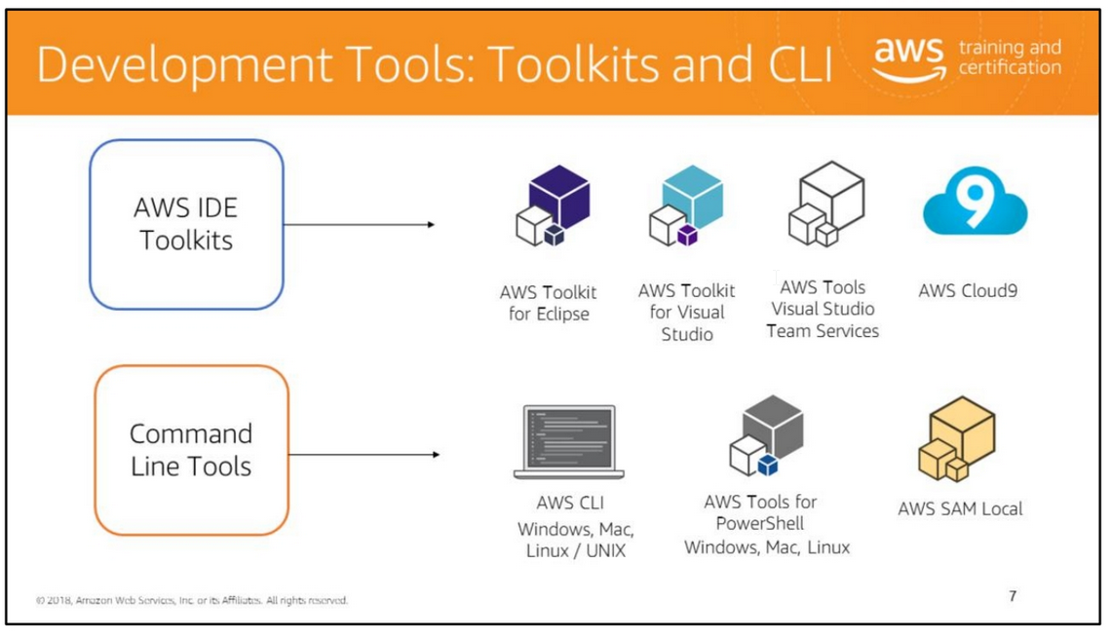
AWS provides a robust set of tools for developers to develop applications that will run on AWS.
AWS IDE Toolkit AWS provides IDE toolkits for Eclipse, Visual Studio, and AWS Cloud9 to help with development on these IDEs.
Command Line Tools You can also use AWS services through a command line interface (CLI) and script usage and management of services. Download the AWS CLI: http://aws.amazon.com/cli/.
For more information, see https://aws.amazon.com/tools/.
The AWS CLI is available for use on Linux, Windows, and Macintosh platforms. It can also be installed on Linux and Windows EC2 instances. The aws configure command can be used on machines hosting the AWS CLI to set a number of defaults for all AWS CLI commands. Chief among these are the access key ID and the secret access key associated with the IAM account that you will use to access AWS resources. You can also specify a default region for all commands.

Slide 9
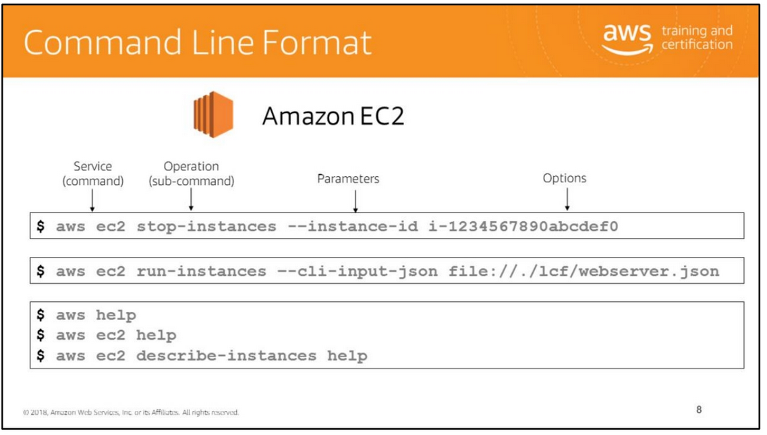
The basic structure of an AWS command line call is the aws command, followed by the following three parts:
command: The top-level service that you are calling (for example, Amazon EC2, Amazon CloudWatch). A list of currently supported services can be found at http://docs.aws.amazon.com/cli/latest/reference/. In the example at the bottom of this slide, we are calling the Amazon EC2 service.
subcommand: The operation to perform on that service (ex.: run-instances, put-metric-data). In this slide’s Amazon EC2 example, we are using the run-instances subcommand to request the creation of a new Amazon EC2 instance.
parameters: Any arguments required to perform the operation. Argument names are preceded by two dashes (--). For example, to execute the Amazon EC2 run instances operation, we pass in a number of parameters, such as the AMI ID, to create the instance.
options: The CLI also provides choices that you can specify when executing operation. For example, you can use the --query option to limit the response text so that it returns only the instance ID of your new instance.

Slide 10
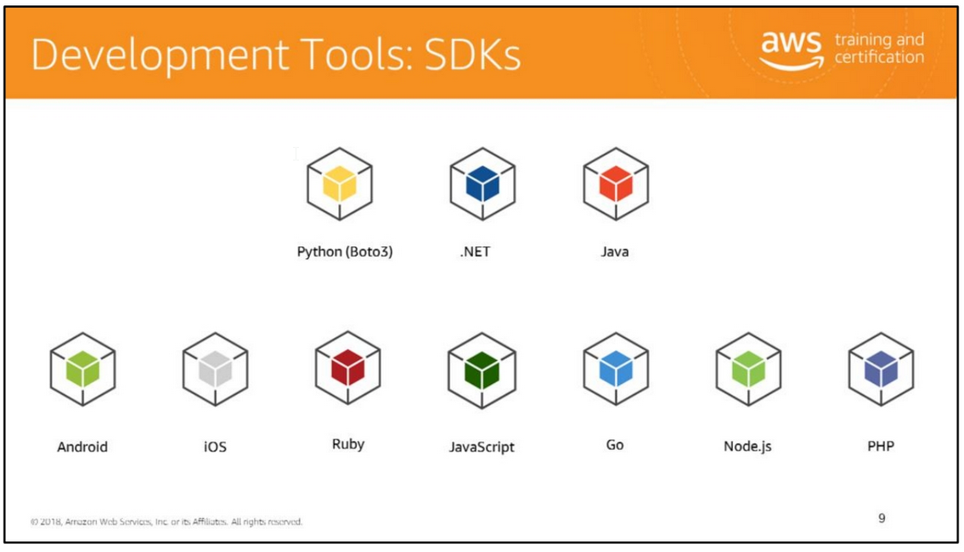
AWS provides a robust set of tools for developers to develop applications that will run on AWS.
AWS SDK Consider the example of a music sharing application. The application needs to upload the user’s music files to an S3 bucket. In this case, the application might use the AWS SDK to programmatically upload files to the S3 bucket.
The AWS SDK enables you to use AWS services in your application in the programming language of your choice. SDKs are available in a number of programming languages and technology platforms such as Android, iOS, Go, Java, JavaScript, .NET, Node.js, PHP, Python, and Ruby.
See SDK installation instructions for the following programming languages:
• Java: http://docs.aws.amazon.com/AWSSdkDocsJava/latest/DeveloperGuide/java-dg-install-sdk.html
• .NET: • http://docs.aws.amazon.com/AWSSdkDocsNET/latest/V3/DeveloperGuide/ net-dg-install-assemblies.html
• http://docs.aws.amazon.com/AWSSdkDocsNET/latest/V3/DeveloperGuide/ net-dg-start-new-project.html
Python: https://boto3.readthedocs.org/en/latest/guide/quickstart.htm

Slide 11
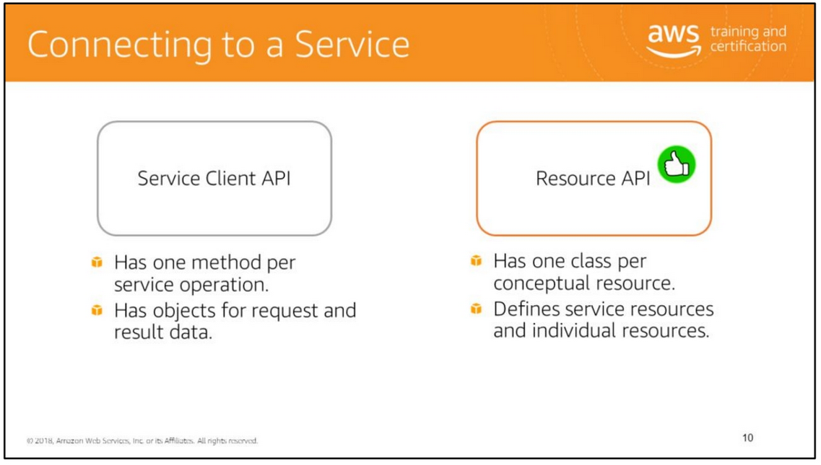
You can connect to an AWS service by using the service client API or the resource API.
AWS SDKs generally have robust support for the service client API. Support for the resource API is quite mature in the Boto 3 SDK for Python and is rapidly growing in AWS SDKs for other languages.
Service Client API AWS SDKs provide a set of client classes, each exposing a direct mapping of the AWS service's API.
These client objects have a method for each operation that the service supports, with corresponding objects representing the request parameters and the response data. Using this "low-level" client API gives you full control over the requests you make to the service, enabling you to very tightly control the behavior and performance of your calls to AWS services.
For example, the AWS SDK for Java and .NET have Amazon<Service>Client classes corresponding to each service such as AmazonS3Client and AmazonDynamoDBClient.

Slide 12
Resource API Some AWS SDKs, such as the Boto 3 SDK for Python, provide higher-level APIs called the resource APIs. The resource APIs provide a higher level abstraction than the low-level calls made by clients. Instead of a single client object exposing a service's entire API, the resource APIs consist of classes representing each of the conceptual resources that you interact with when using a service. These classes expose methods to retrieve data about the resource, invoke actions that can be taken on the resource, and retrieve links to other related resources.
Resources include service resources such as Amazon S3 or Amazon SQS and individual resources such as a bucket or a queue. Individual resources have an identifier and attributes.
For example, the Amazon S3 service resource exposes methods to perform actions on the Amazon S3 service.
An Amazon S3 individual resource such as an object has an identifier or object key and attributes such as last_modified.
For more information, see http://boto3.readthedocs.org/en/latest/guide/resources.html.
Resource APIs are easier to understand and simpler to use as they provide a higher level abstraction than client APIs.

Slide 13
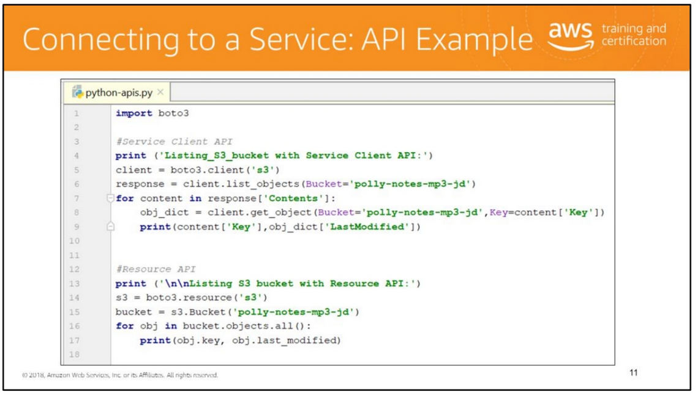

Slide 14
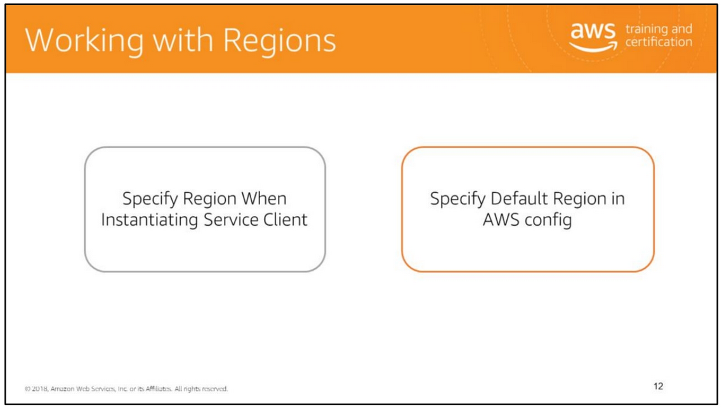
AWS regions allow you to access AWS services that physically reside in a specific geographic region. How you specify the region to work with depends on which AWS SDK you are going to use.
With some AWS SDKs such as the AWS SDKs for Java and .NET, you can specify the region when instantiating the service client or set it soon after the client has been instantiated. You must create a separate instance of the service client for every region that you wish to work with.
Other SDKs such as the Boto 3 SDK for Python, can use the default region that is set in the ~/.aws/config file.
For more information, see:
• Java: http://docs.aws.amazon.com/AWSSdkDocsJava/latest/DeveloperGuide/java-dg-region-selection.html
• .NET: http://docs.aws.amazon.com/AWSSdkDocsNET/latest/V3/DeveloperGuide/n et-dg-config.html
• Boto 3: http://boto3.readthedocs.org/en/latest/guide/quickstart.html#configuration

Slide 15
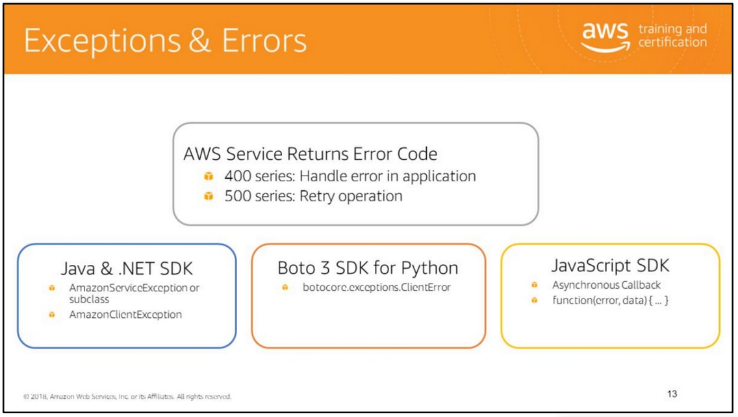
For more information, see:
• Java: http://docs.aws.amazon.com/AWSSdkDocsJava/latest/DeveloperGuide/java-dg-region-selection.html
• .NET: http://docs.aws.amazon.com/AWSSdkDocsNET/latest/V3/DeveloperGuide/n et-dg-config.html
• Boto 3: http://boto3.readthedocs.org/en/latest/guide/quickstart.html#configuration

Slide 16
The AWS SDK for Java throws the following unchecked (runtime) exceptions when errors occur:
• com.amazonaws.AmazonServiceException: This exception (or its subclass) indicates that the request was correctly transmitted to the service, but for some reason, the service was not able to process it, and returned an error response instead. The exception has the following information that you can use to determine how your application should handle the error:
• The HTTP status code returned by the service
• The AWS error code returned by the service
• The detailed error message from the service
• The AWS request ID for the failed request
com.amazonaws.AmazonClientException: This exception indicates that a problem occurred inside the Java client code, either while trying to send a request to AWS or while trying to parse a response from AWS. For example, the AWS SDK for Java will throw an AmazonClientException if no network connection is available when you try to call an operation on one of the clients.
java.lang.IllegalArgumentException: This exception s thrown if you pass an illegal argument when performing an operation on a service.
For more information, see http://docs.aws.amazon.com/AWSSdkDocsJava/latest/DeveloperGuide/java-dg-exceptions.html.
AWS SDK for .NET The AWS SDK for .NET throws Amazon.Runtime.AmazonServiceException and Amazon.Runtime.AmazonClientException similar to the AWS SDK for Java.
Boto 3 SDK for Python Boto 3 SDK throws botocore.exceptions.ClientError in case of errors.
AWS SDK for JavaScript Each service method that sends a request can accept a callback as the last parameter with the signature function(error, data) { ... }. This callback will be called when the response or error data is available. For more information, see the following pages:
• JavaScript in the browser: http://docs.aws.amazon.com/AWSJavaScriptSDK/guide/browser-making-requests.html
• JavaScript in Node.js: http://docs.aws.amazon.com/AWSJavaScriptSDK/guide/node-making-requests.html

Slide 17
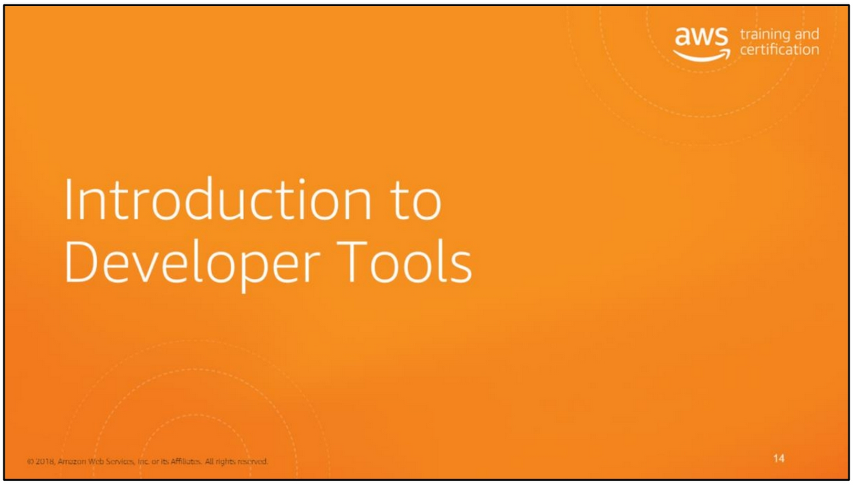

Slide 18
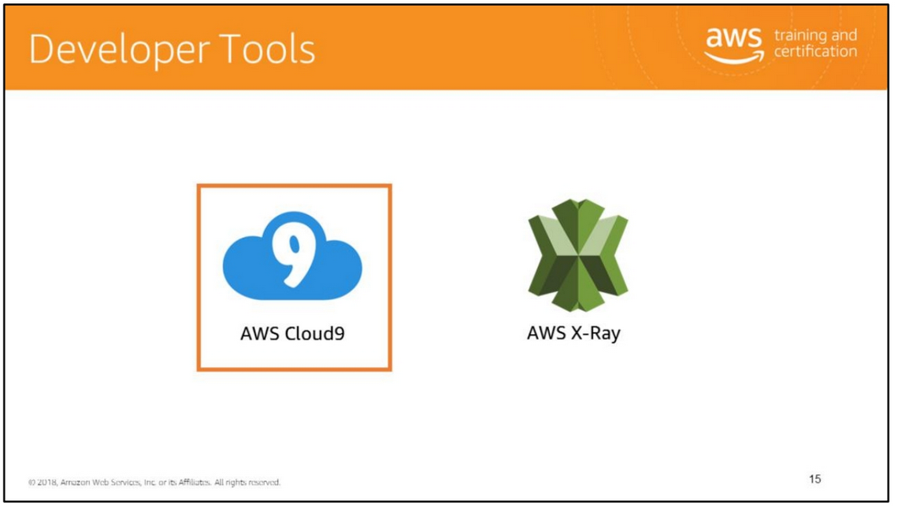

Slide 19
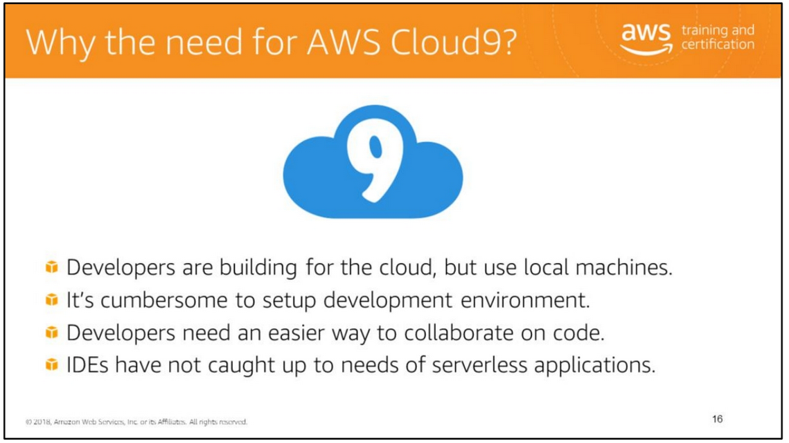
Pain points for developers:
• Rely on local machine’s hardware/configuration.
• Hard to multi-task on various projects.
• Difficult to work from multiple locations.
Developers need an easier way to collaborate on code. Looking over each other’s screen does not scale well. Screen sharing tools make developers constantly switch contexts.

Slide 20
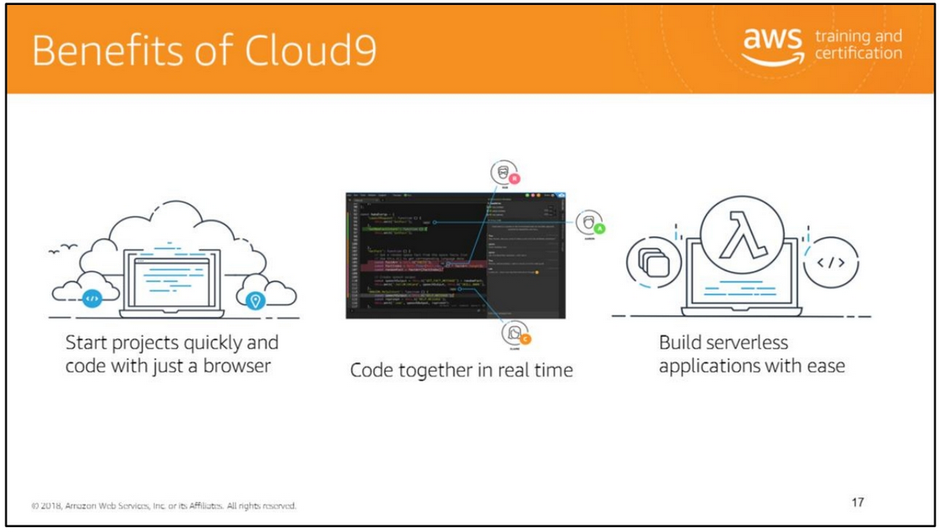
We recommend the following best practices for using your AWS Cloud9 environment:
• Use source control and backup your environment frequently. AWS Cloud9 does not perform automatic backups.
• Perform regular updates of software on your environment. AWS Cloud9 does not perform automatic updates on your behalf.
• Turn on AWS CloudTrail in your AWS account to track activity in your environment.
• Only share your environment with trusted users. Sharing your environment may put your AWS access credentials at risk.

Slide 21
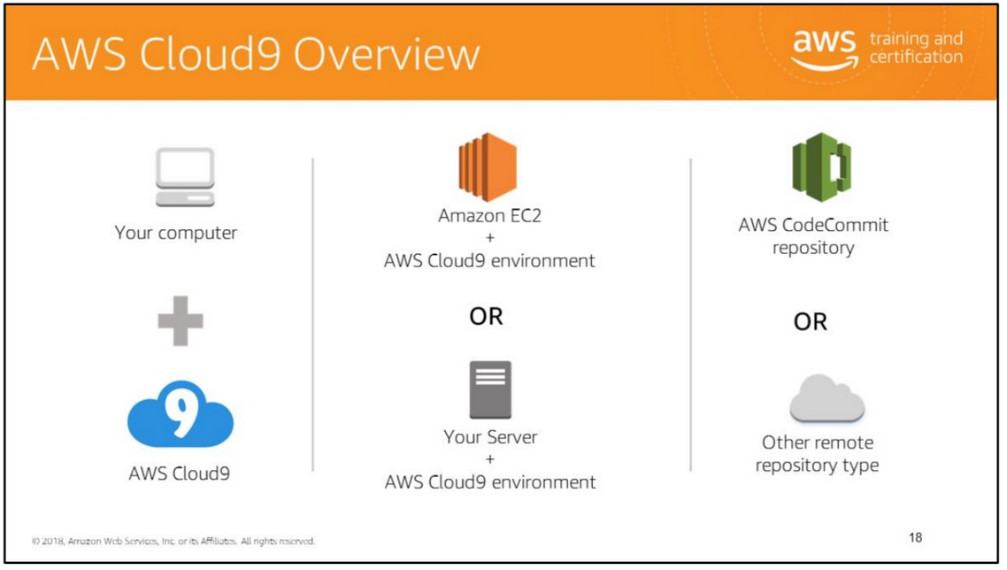
You use the AWS Cloud9 IDE, running in a web browser on your local computer, to interact with your environment. An Amazon EC2 instance or your own server connects to the environment. An environment is a place where you store your project's files and where you run the tools to develop your apps.
You use the AWS Cloud9 IDE to work with files in the environment. You can:
• Store these files locally on the instance or server.
• Clone a remote code repository—such as a repo in AWS CodeCommit—into your environment.
• Work with a combination of local and cloned files in the environment.

Slide 22
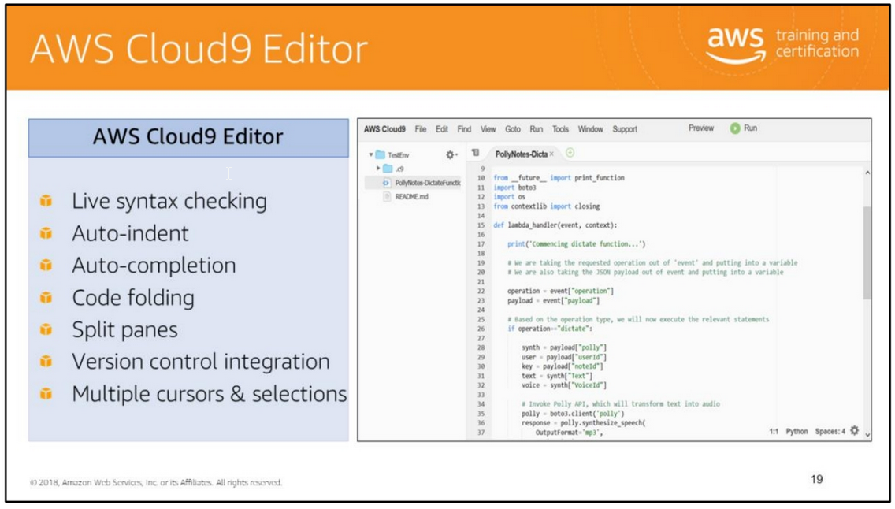
The Ace Editor at the core of Cloud9 is what lets you write code quickly and easily. It has standard IDE features: live syntax checking, auto-indent, auto-completion, code folding, split panes, version control integration, multiple cursors and selections. It’s fast, even for large (100,000+ line) files. There’s no lag or other issues while typing. It has more than two dozen themes built-in (solarized!), and you can bring all of your favorite themes from Sublime Text or TextMate as well. It has built-in support for 40+ language modes and customizable run configurations for your projects. Most importantly, though, it has Vim mode (or emacs if your fingers work that way). It also has a keybinding editor that allows you to bend the editor to your will.
The editor supports powerful keyboard navigation and commands (similar to Sublime Text or vim plugins like ctrlp). On a Mac, with⌘+P, you can open any file in your environment with fuzzy search. With⌘you can open up the command pane, which allows you to do invoke any of the editor commands by typing the name. It also helpfully displays the keybindings for a command in the pane—for instance, to open to a terminal, you can press ⌥+T. It also ships with the AWS CLI preconfigured for access to your resources.
The environment also comes with pre-installed debugging tools for many popular languages—but you’re not limited to what’s already installed. It’s easy to add new programs and define new run configurations.

Slide 23
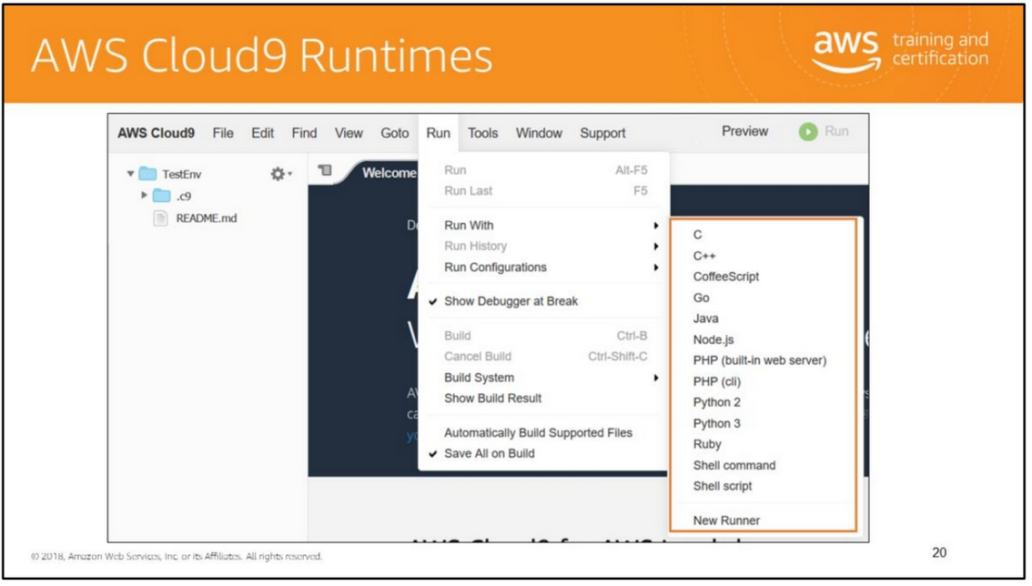

Slide 24
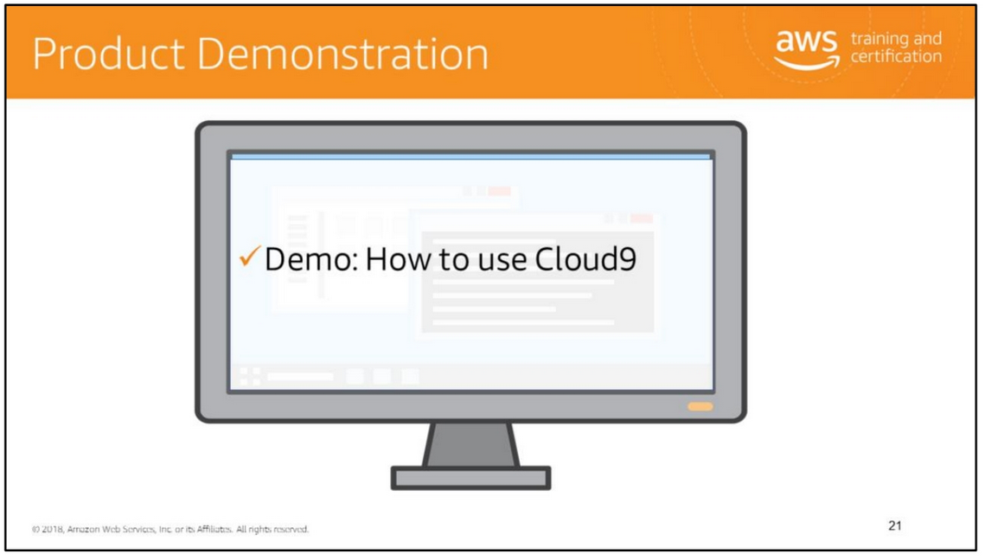

Slide 25
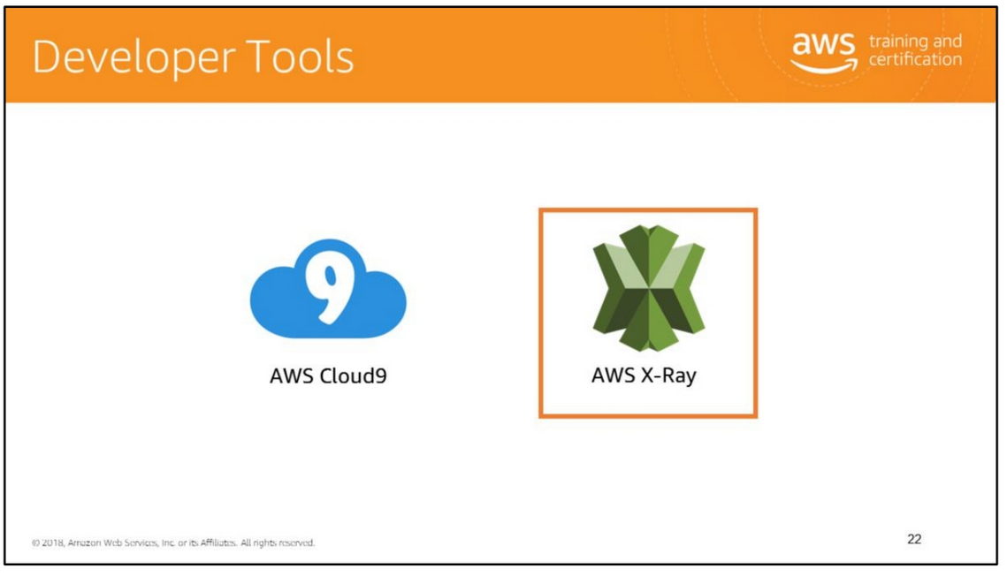

Slide 26
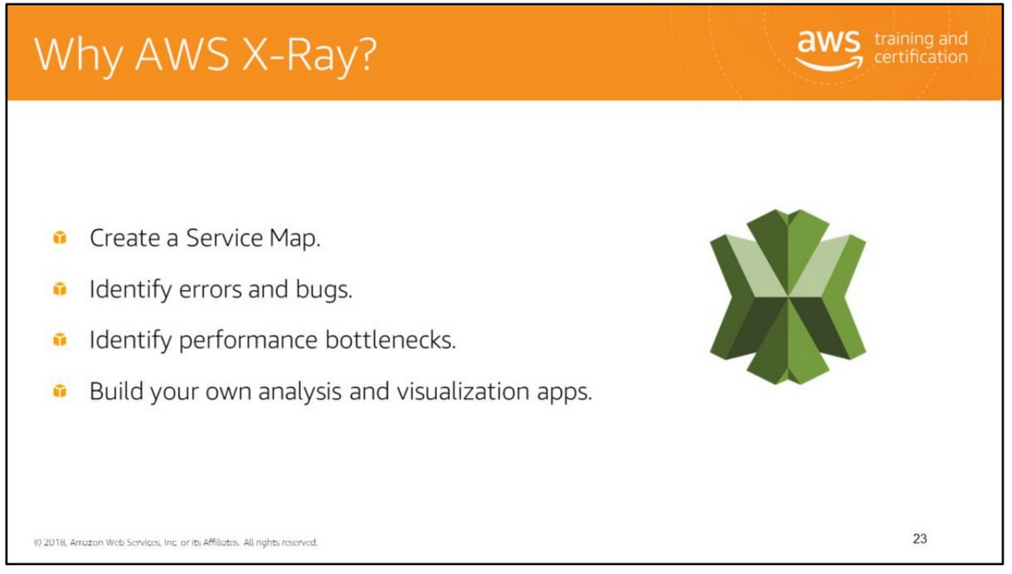
AWS X-Ray helps developers analyze and debug production, distributed applications, such as those built using a microservices architecture. With X-Ray, you can understand how your application and its underlying services are performing to identify and troubleshoot the root cause of performance issues and errors. X-Ray provides an end-to-end view of requests as they travel through your application, and shows a map of your application’s underlying components. You can use X-Ray to analyze both applications in development and in production, from simple three-tier applications to complex microservices applications consisting of thousands of services.
X-Ray makes it easy for you to:
• Create a service map – By tracking requests made to your applications, X-Ray can create a map of services used by your application. This provides you with a view of connections among services in your application, and enables you to create a dependency tree, detect latency or errors when working across AWS Availability Zones or Regions zero in on services not operating as expected, and so on.
• Identify errors and bugs – X-Ray can automatically highlight bugs or errors in your application code by analyzing the response code for each request made to your application. This enables easy debugging of application code without requiring you to reproduce the bug or error.
• Identify performance bottlenecks - AWS X-Ray helps you identify performance bottlenecks. X-Ray’s service maps let you see relationships between services and resources in your application in real time. You can easily detect where high latencies are occurring, visualize node and edge latency distribution for services, and then drill down into the specific services and paths impacting application performance.
• Build your own analysis and visualization apps – X-Ray provides a set of query APIs you can use to build your own analysis and visualizations apps that use the data that X-Ray records.

Slide 27
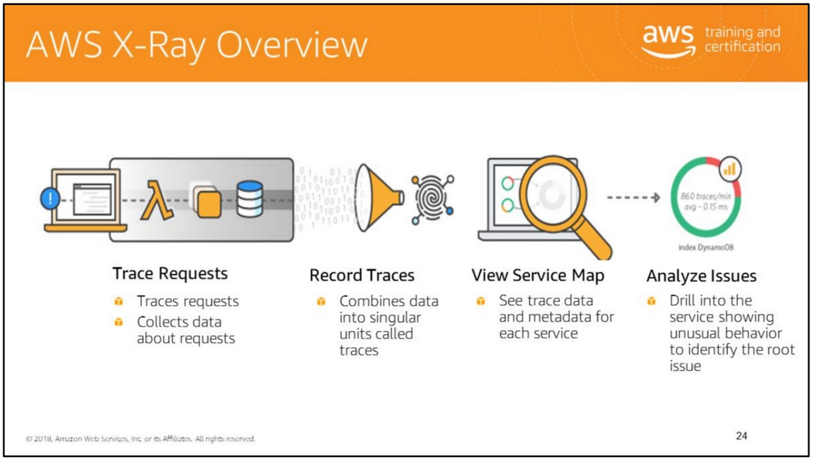
AWS X-Ray is a service that collects data about requests that your application serves, and provides tools you can use to view, filter, and gain insights into that data to identify issues and opportunities for optimization. For any traced request to your application, you can see detailed information not only about the request and response, but also about calls that your application makes to downstream AWS resources, microservices, databases and HTTP web APIs.

Slide 28
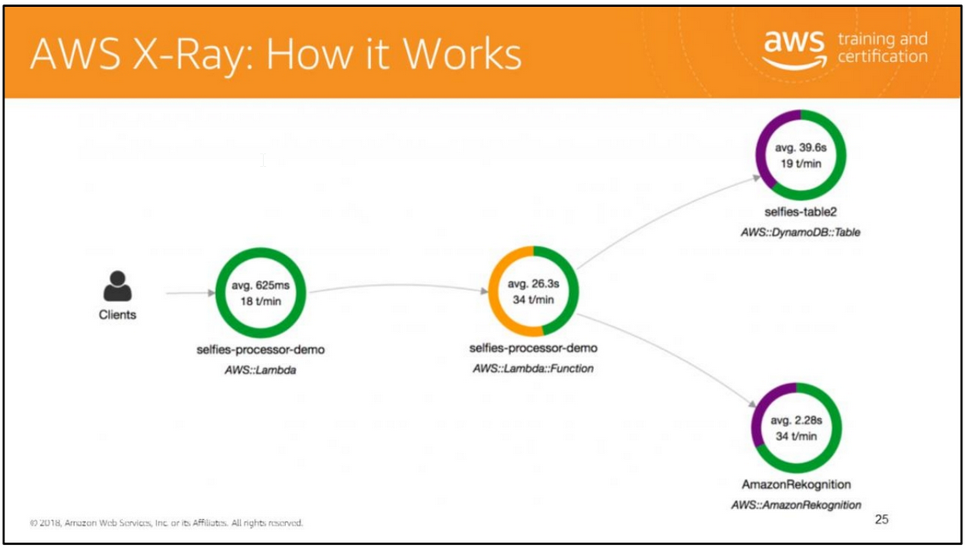
The X-Ray service graph gives you a visual representation of services and their interactions over a period of time that you select. The nodes represent services and the edges between the nodes represent calls between the services. The nodes and edges each have a set of statistics associated with them. While the visualizations provided in the service map are useful for estimating the average latency in an application they don’t help you to dive deep on specific issues. Most of the time issues occur at statistical outliers. To alleviate this X-Ray computes histograms like the one above help you solve those 99th percentile bugs.

Slide 29
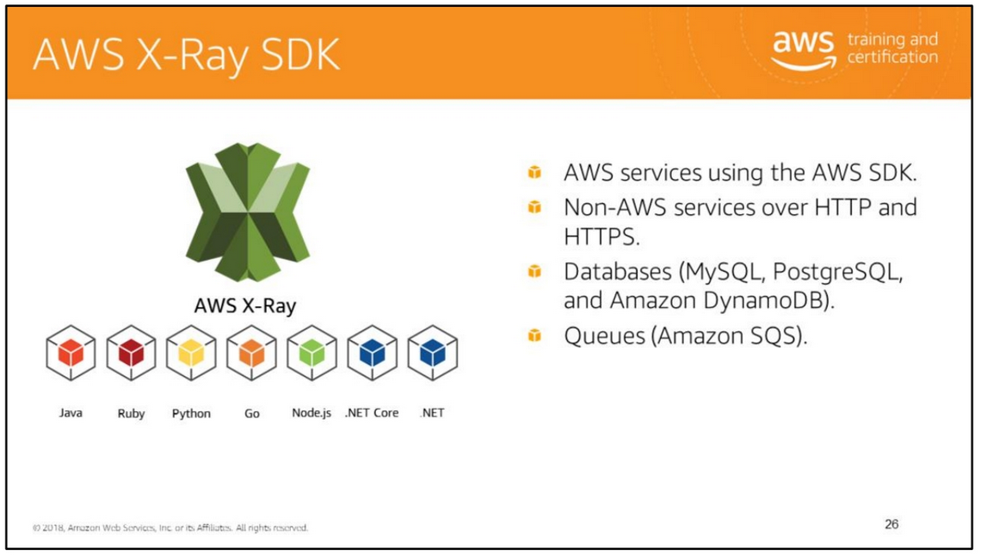
For more information, see https://github.com/aws?q=xray-sdk

Slide 30
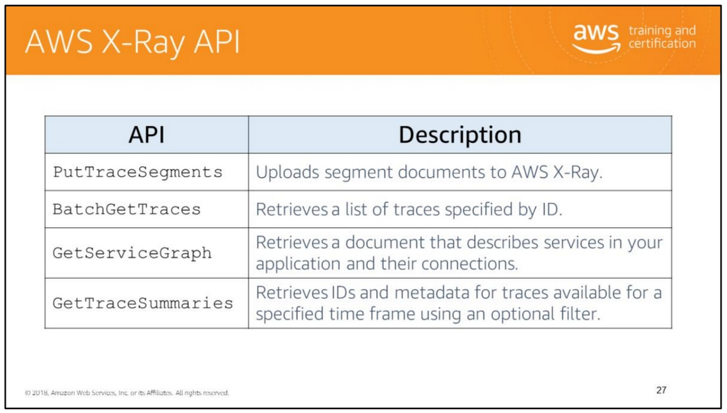
AWS X-Ray provides a set of APIs to enable you to send, filter, and retrieve trace data.
You can send trace data directly to the service without having to use our SDKs (that is, you can write your own SDKs for languages not currently supported).
Raw trace data is available using batch get APIs. You can build your own data analysis applications on top of the data collected by X-Ray.

Slide 31
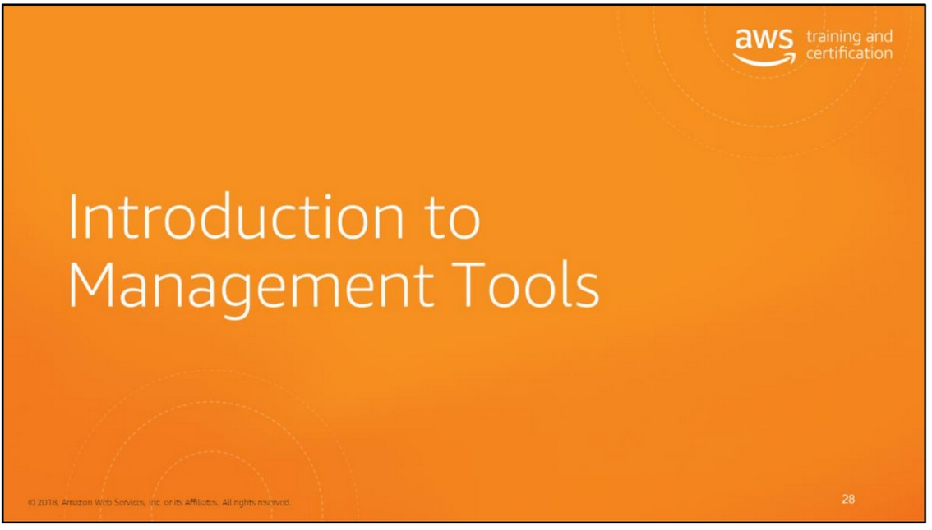

Slide 32
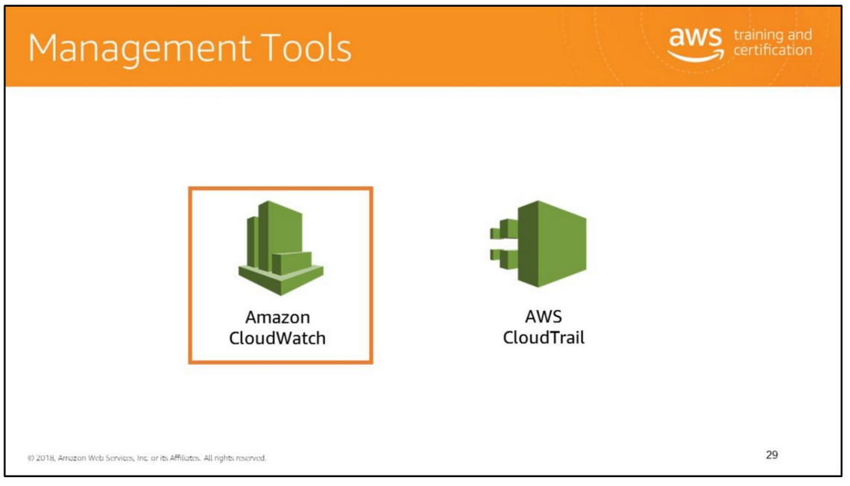

Slide 33
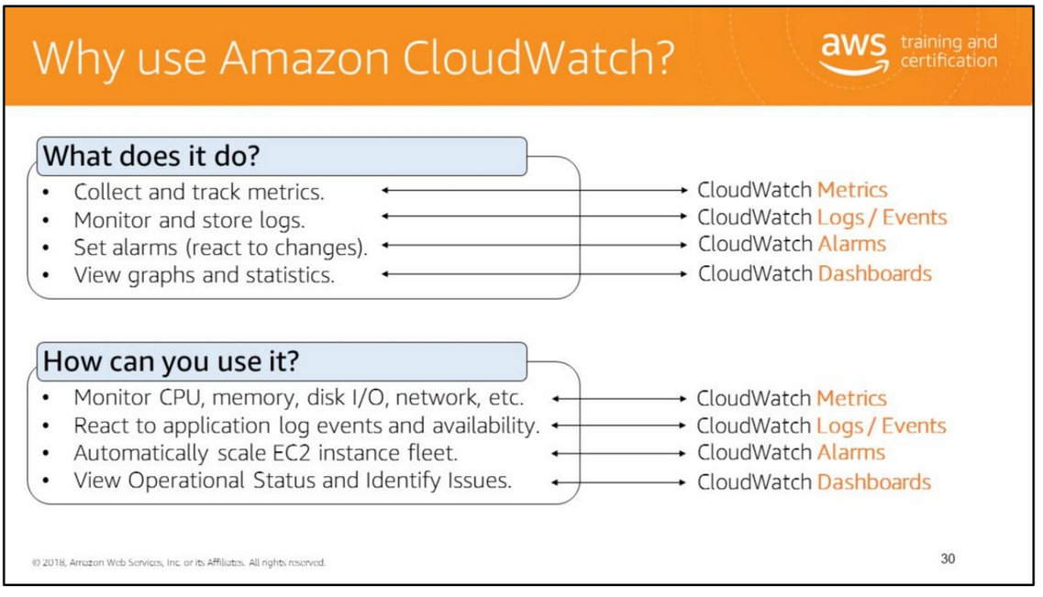
You can use Amazon CloudWatch to gain system-wide visibility into resource utilization, application performance, and operational health. You can use these insights to react and keep your application running smoothly. Amazon CloudWatch monitors your AWS cloud resources and your cloud-powered applications. It tracks the metrics so that you can visualize and review them. You can also set alarms that will fire when a metrics goes beyond a limit that you specified. CloudWatch gives you visibility into resource utilization, application performance, and operational health.

Slide 34
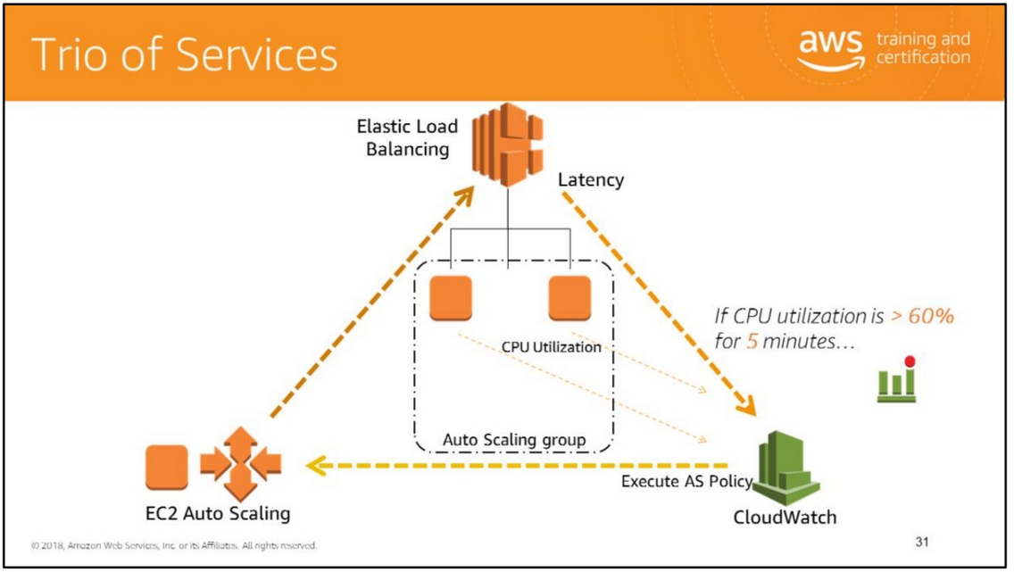
CloudWatch is basically a metrics repository. CloudWatch provides a powerful mechanism for monitoring the state and utilization of most of the resources you are managing under AWS. Here we are show casing that CloudWatch has the ability not only to create metrics, but to create alarms off of those metrics.
Auto Scaling works as a trio of services working in sync. Elastic Load Balancing and EC2 instances feed metrics to Amazon CloudWatch. Auto Scaling defines a group with launch configurations and Auto Scaling policies. Amazon CloudWatch alarms execute Auto Scaling policies to affect the size of your fleet. All of these services work well individually, but together they become more powerful and increase the control and flexibility our customers demand.

Slide 35
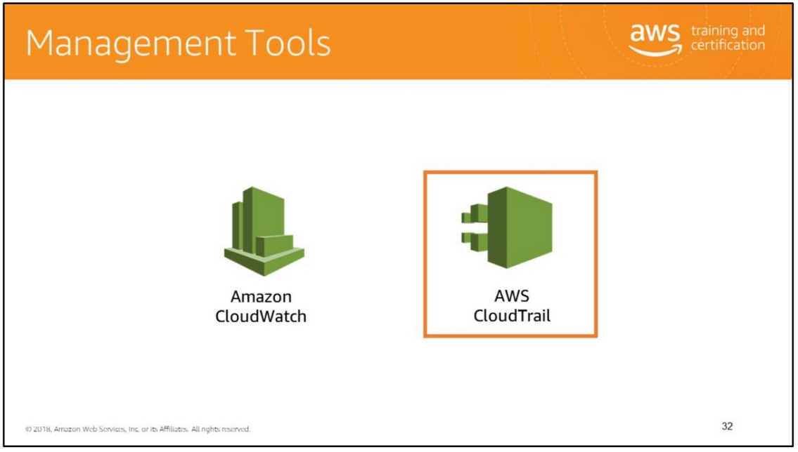

Slide 36
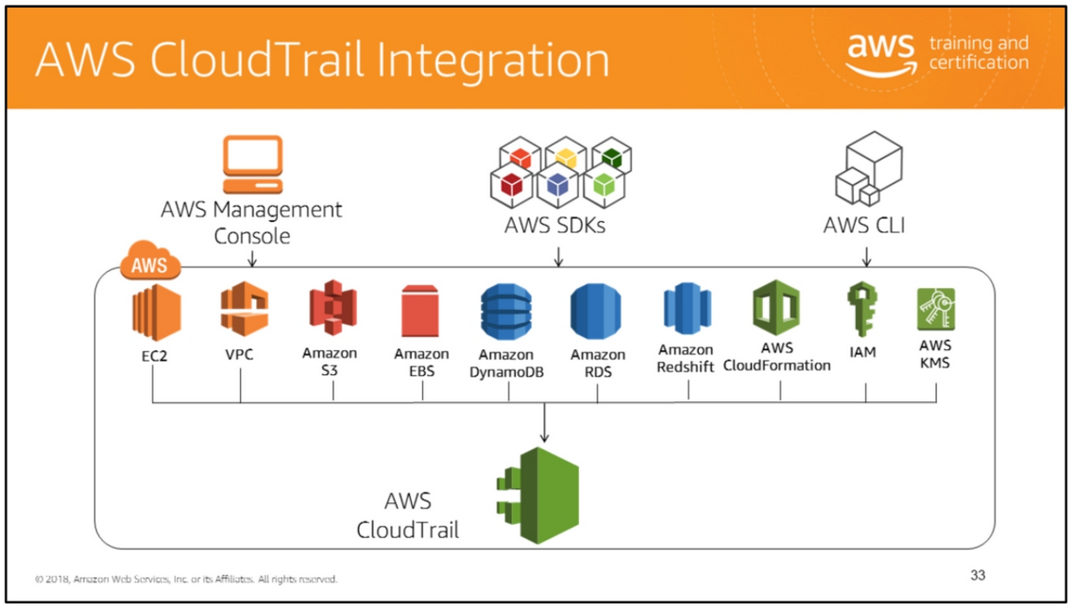
AWS CloudTrail is integrated with several AWS services.
For a complete list of AWS services that support AWS CloudTrail, see http://docs.aws.amazon.com/awscloudtrail/latest/userguide/cloudtrail-supported-services.html.
You can also use the S3 notifications feature to automatically receive a notification when a log file is stored in your S3 bucket. You can also integrate CloudTrail with SNS and SQS to receive automatic notifications when logs are generated using CloudTrail.

Slide 37
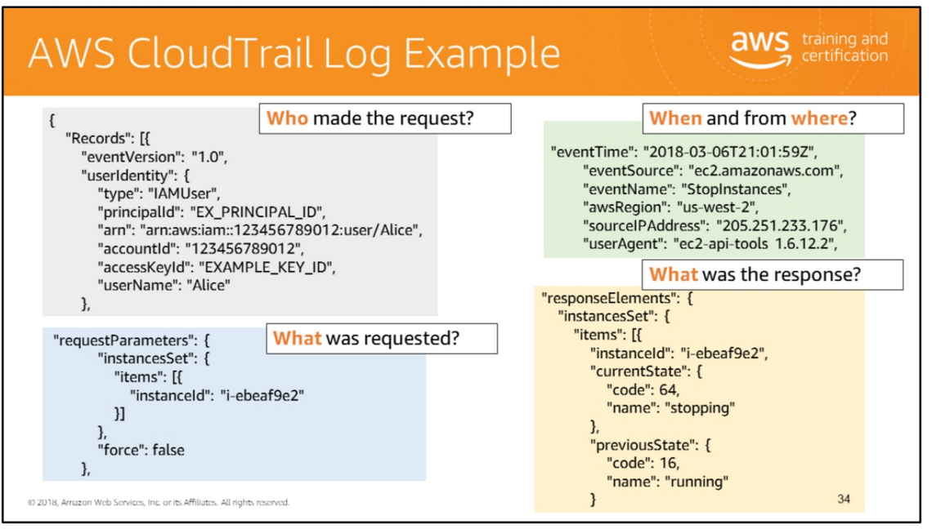
AWS CloudTrail is an AWS service that generates logs of calls to the AWS API. Because the AWS API underlies both the Command Line Interface (CLI) and the AWS Management Console, AWS CloudTrail can record all activity against the services it monitors.
Here are questions that you can answer using CloudTrail logs: who, when, what, which, where? While the coverage is extensive, please note that not all services are covered in CloudTrail logs.
You can use the AWS API call history produced by CloudTrail to track changes to AWS resources, including creation, modification, and deletion of AWS resources such as Amazon EC2 instances, Amazon VPC security groups, and Amazon EBS volumes.
The log file record example on the slide shows that an IAM user named Alice called the Amazon EC2 StopInstances action by using the ec2-stop-instances command in the CLI.

Slide 38
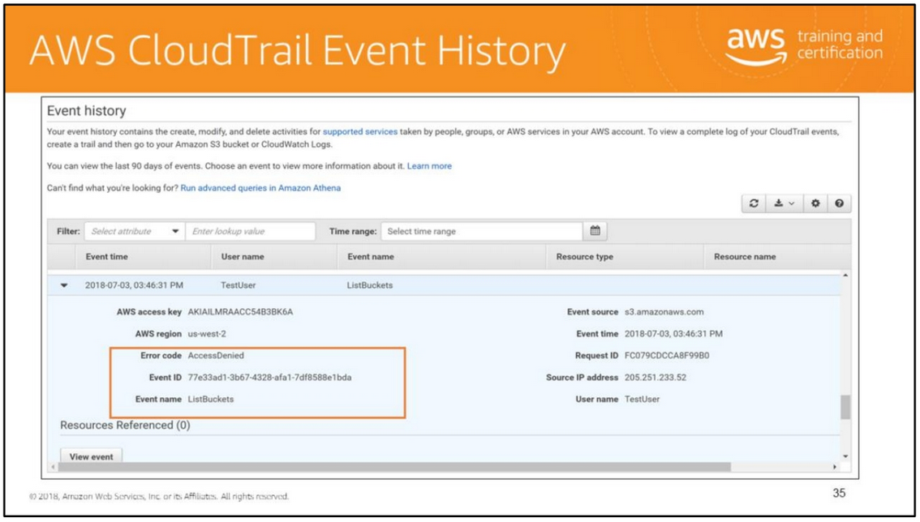
You can use the CloudTrail console to view the last 90 days of recorded API activity and events in an AWS Region. You can also download a file with that information, or a subset of information based on the filter and time range you choose. You can customize your view of event history by selecting which columns are displayed in the console. You can also look up and filter events by the resource types available for a particular service.
CloudTrail logging varies between AWS services. While most AWS services support CloudTrail logging of all events, some services only support logging a subset of APIs and events, and a few services are unsupported. You can learn more about the specifics of how CloudTrail logs events for a specific service by consulting the documentation for that service.
For more information, see https://docs.aws.amazon.com/awscloudtrail/latest/userguide/view-cloudtrail-events.html .

Slide 39
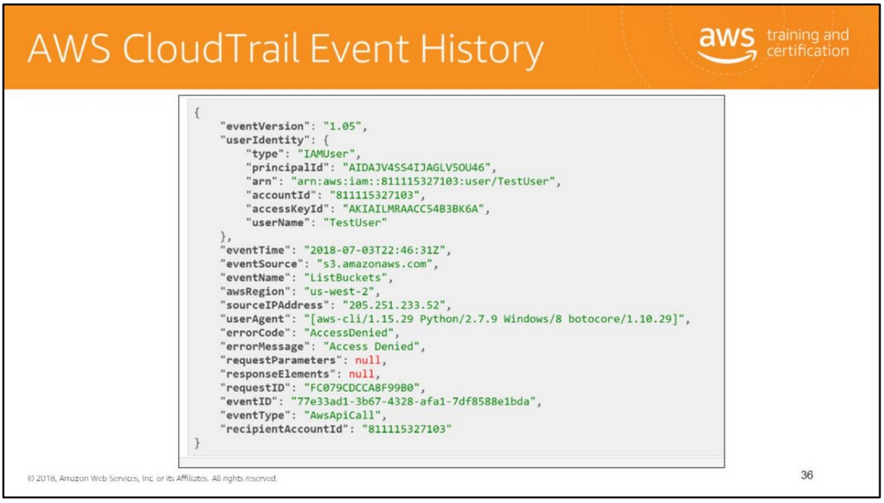
The screen capture shows the details in the View Events for the history.

Slide 40
Amazon CloudWatch focuses on performance monitoring and system health.
CloudTrail focuses on API activity. Although CloudTrail does not report on system performance or health, you can use CloudTrail with CloudWatch alarms to notify you about activity that you might be interested in. Who what when and where on API calls
Partner Solutions AWS partners with third-party specialists in logging and analysis to provide solutions that use CloudTrail output. For more information, visit the CloudTrail detail page at AWS CloudTrail. Javascript is disabled or is unavailable in your browser. To use the AWS Documentation, Javascript must be enabled. Please refer to your browser's Help pages for instructions. Document Conventions CloudTrail Workflow CloudTrail Supported Regions

Slide 41


Slide 42
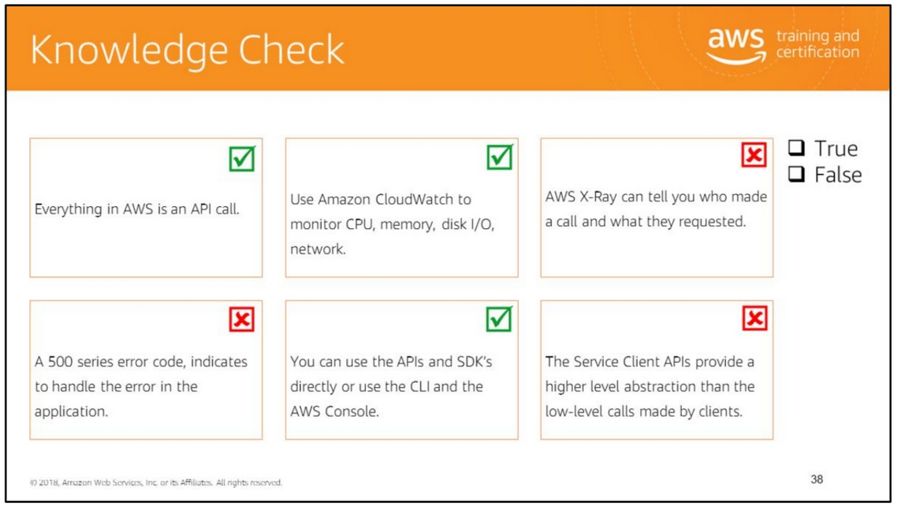
Read left to right:
(True)
(True)
(False) You use AWS CloudTrail to find out who made a call and what they requested.
(False) When an error occurs, an AWS service returns an error code that you can use to determine how to handle the error. A 400 series error code, indicates to handle the error in the application. Sometimes an AWS service can return an error code such as 500 indicating an internal server error.
(True)
(False) The Resource APIs provide a higher level abstraction than the low-level calls made by clients.

Slide 43
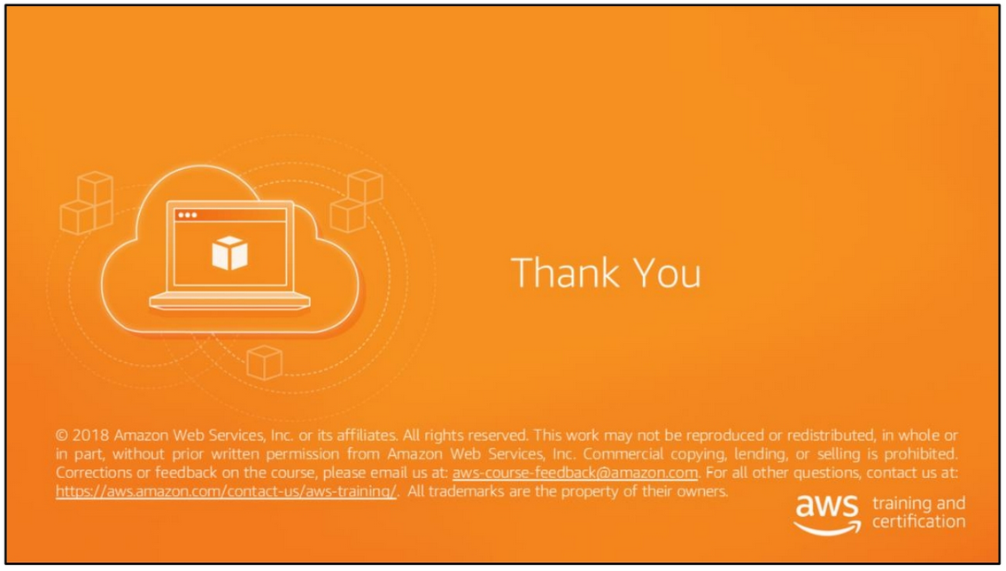

Slide 44
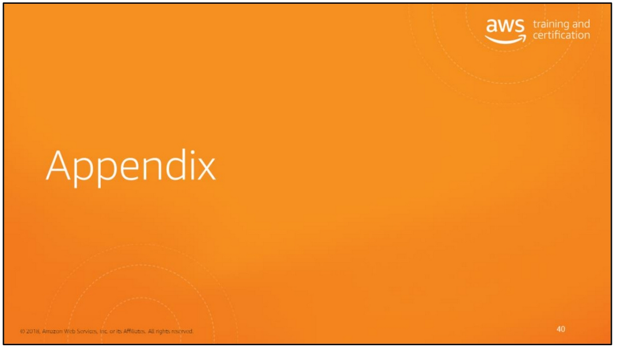

Slide 45
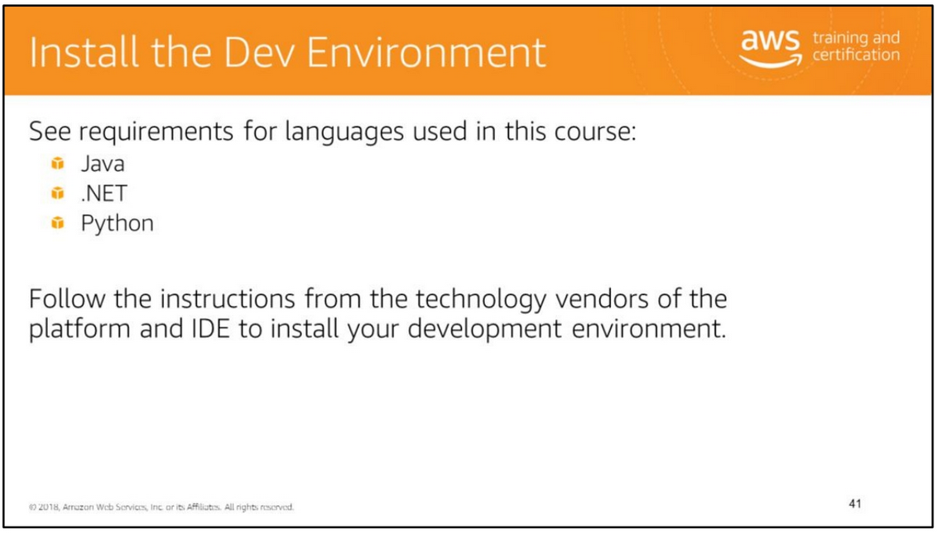
For information about setting up your development environment, see instructions for the following programming languages:
• Java: http://docs.aws.amazon.com/AWSSdkDocsJava/latest/DeveloperGuide/java-dg-java-env.html
• .NET: http://docs.aws.amazon.com/AWSSdkDocsNET/latest/V3/DeveloperGuide/net-dg-dev-env.html
• Python (version 3.6): https://aws.amazon.com/about-aws/whats-new/2015/06/boto3-aws-sdk-for-python-version-3-is-now-generally-available/
The lab environment has been pre-configured with the SDKs and tools for the programming languages that are supported in this course.

Slide 46
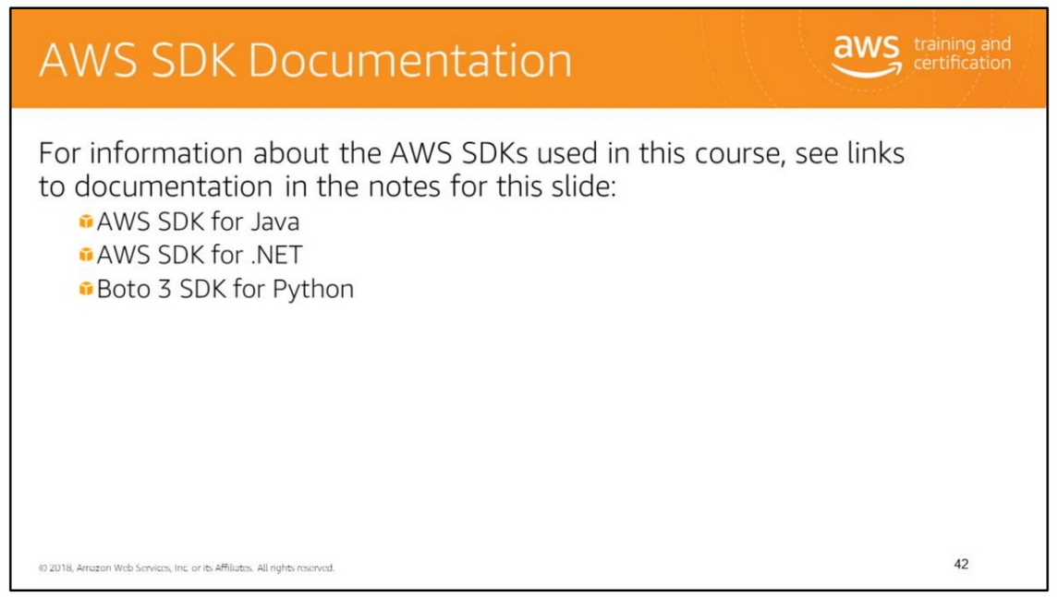
For all developer related information,
see the Developers tab in the AWS Documentation page –
http://aws.amazon.com/documentation/.
For information about the AWS SDKs used in this course,
see the following links to documentation:
• Java:
• Developer Guide:
http://docs.aws.amazon.com/AWSSdkDocsJava/latest/DeveloperGuide/welcome. html
• API documentation:
http://docs.aws.amazon.com/AWSJavaSDK/latest/javadoc/index.html
• .NET
• Developer Guide:
http://docs.aws.amazon.com/AWSSdkDocsNET/latest/V3/DeveloperGuide/welco me.html
• API Documentation:
http://docs.aws.amazon.com/sdkfornet/v3/apidocs/Index.html
• Boto 3 (Python)
• Developer Guide: https://boto3.readthedocs.org/en/latest/
• API Documentation:
https://boto3.readthedocs.org/en/latest/reference/core/index.html

Slide 47
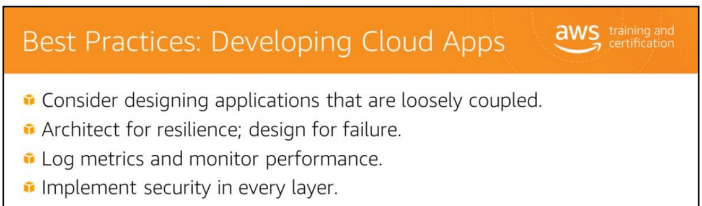
Follow these guidelines when designing and developing applications that will run in the cloud:
• Consider designing applications that are loosely coupled: Compute, network, storage, and many other technology components are delivered as services by AWS. Think of your application as a consumer and provider of services. Design and develop your application as granular components (microservices) that can be delivered and scaled independently.
• Architect for resilience: Architect your application such that it can react gracefully and quickly to spikes in volume or unexpected failures. Examples of architecting for resilience are as follows:
• You might set up your servers to scale automatically based on the number of users concurrently visiting your application. Auto scaling would enable your application to handle a surge in volume during a sale or promotion and go back to normal operating levels when the sale is over.
• You could set up a cluster of nodes such that when one node fails, another node automatically picks up all the traffic.
• You might consider setting up read replicas for your database. This will shift read-heavy workloads away from your main database instance and provide better throughput for write operations.

Slide 48
•Design for failure: Services might become completely unavailable or might show increased latency if there is an unexpected surge in activity. Design applications to handle and survive failures. Catch service exceptions and handle them appropriately. In case of service failure, your application may log the failure and retry at a later time. If the service is slow to respond, your application could retry by using an exponential backoff algorithm: retry after increasing amounts of time between attempts. For example, retry after two seconds, then retry after four seconds and so on. This approach attempts to reach the service without overwhelming it with repeated requests and potentially aggravating the latency issue.
• Log metrics and monitor performance: Incorporate instrumentation in all your services, log usage metrics and failures, and monitor performance. Measuring, recording, and monitoring performance is critical to building a high-performance application.
• Implement a strong DevOps model: Operationalize the development and deployment process for your application. Develop a modular, automated, and continuous build process. Ensure consistency in the development, staging, and production environments. Set up scripts or use robust tools to consistently configure your environments. A strong DevOps model will help you develop and deliver updates quickly and flawlessly.
• Be aware of security and regulatory restrictions: Security and regulatory restrictions can vary by location. These restrictions can impact the design and implementation of your application and restrict where sensitive data can be stored. You may not be able to use certain services if they are not available in a specific region. Regulatory restrictions may prevent you from using the service in a different region. Be aware of security and regulatory restrictions that apply to your business. Examples of security and regulatory restrictions:
• The FIPS standard specifies the security requirements for cryptographic modules that protect sensitive information.
• The HIPAA law includes provisions to protect the security and privacy of Protected Health Information (PHI). PHI includes a very wide set of personally identifiable health-related data, from insurance and billing information, to diagnosis data, clinical care data, and lab results
such as images and test results.
• The EU Data Protection Directive refers to the directive on the protection of individuals with regard to the processing of personal data and on the free movement of such data.
For more information, see https://aws.amazon.com/compliance/.
• Implement security in every layer (infrastructure, application, data at transit and at rest, user authentication and authorization): Responsibility for security is shared between you and AWS. It is your responsibility to secure your network, application, and data in transit and at rest, and to control access to your application.

